Slide 1


FrontEnd Web Development- Assignment 1
LaBamBa: Movie Recommender and Reviews
Chan Jia Yi (P7337992)
Date: 26 June 2022
Github: https://github.com/cjy93/MovieRecommender_FullStack

Slide 2
Scrapping data
1) Python Codes located in ‘2022_ScrapeMovies.ipynb’
2) Python requirements set up in ‘requirements.txt’
3) Data located in ‘/data’
4) Other images located in ‘/images’

Slide 3



Agenda
Setting Up
Index.html
aboutUs.html + cathaypromotion.html + goldenVpromotion.html + shawpromotion.html
Listing.html
movieDetail.html
movieDetail_review.html + 0.html + …. + 42.html
Contact.html
Chatbot.html

Slide 4
Tech Stack used
Python BeautifulSoup - webscrapping
Native Javascript - interactivity
D3.js – read and use csv data
API to link html forms to Google Spreadsheet
Rasa and Rasa Webchat – for Recommender system chatbot
HTML - layout
CSS - styling

Slide 5




Setting up
You need some set up in order to run the Rasa chatbot. It has to serve on a Rasa server to interact between app and Rasa models.

Slide 6
Setting up (on Command window)
conda create --name chatbot3 python==3.8
conda activate chatbot3
pip install rasa --use-deprecated=legacy-resolver
pip install sanic==21.9.3
rasa --version

Slide 7
How to Operate Rasa
How to operate my chatbot?
First, access the folder of your command prompt to where this file resides.
1) `conda activate chatbot3` where "chatbot3" is my conda environment with Rasa and NPM installed
2) Go to the folder where your Rasabot resides
3) Run custom actions on first terminal `python -m rasa run actions` by https://learning.rasa.com/archive/rasa-forms-2/custom-actions/
3) Serve on server on second terminal `rasa run -m models --enable-api --cors "*"`
4) Open chatbot.html file on Chrome (can also access via index.html to link here)

Slide 8

Index.html
Main Landing Page/ Home Page

Slide 9
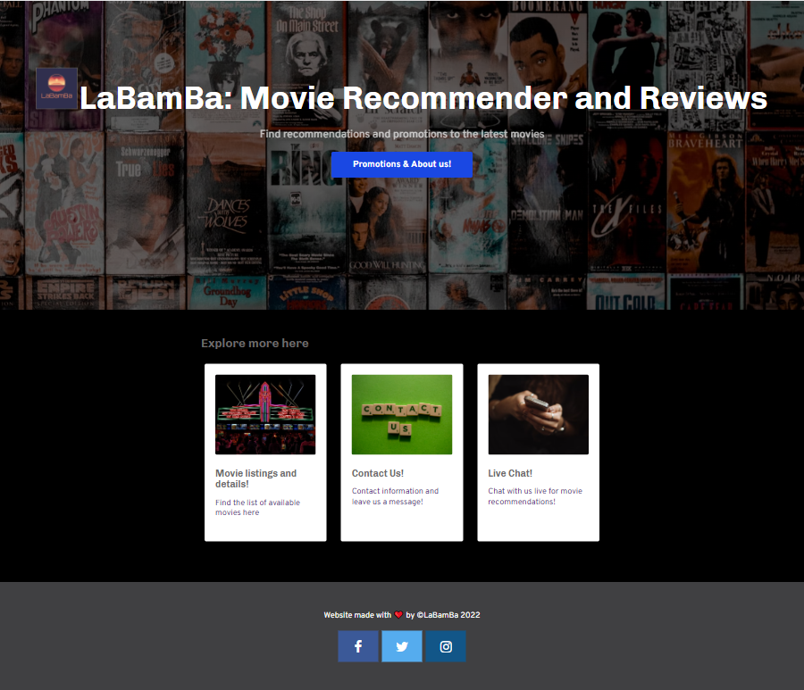
Blue button will lead to `aboutUs.html`
2) Movie listings and details card will lead to `listing.html`
3) Contact us card will lead to `contact.html`
4) Live chat card will lead to `chatbot.html` under the folder “chatbot”. This is powered by Rasabot.

Slide 10
aboutUs.html
About Us and Promotions

Slide 11
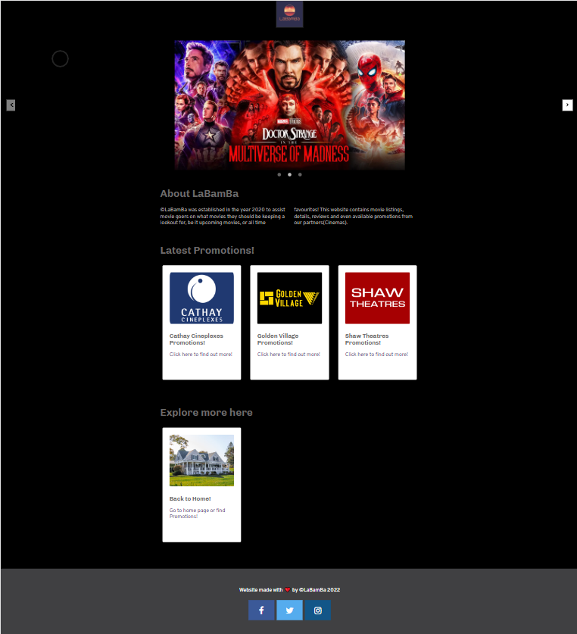
Click on LaBamBa logo for shortcut back to home page
Latest promotions cards will lead to `cathaypromotions.html`, `goldenVpromotions.html` and `shawpromotions.html` respectively.
Navigation cards under `Explore more here` will lead back to homepage too.
The carousel on top is fully written in native Javascript, and is interactive.

Slide 12
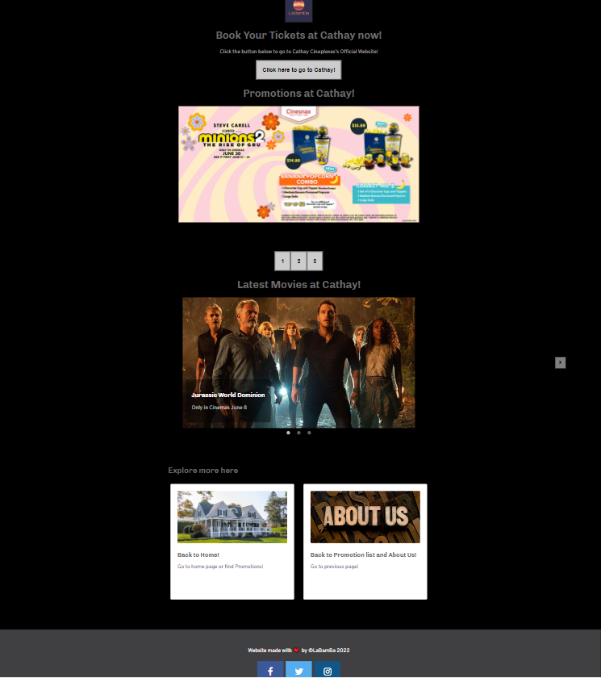
LaBamBa logo will lead us back to home page when clicked
Button “Click here to go to Cathay” leads us to Cathay official website
Promotional pictures are toggleable by clicking on “1” “2” or “3”
Carousell are toggleable by clicking on the circles below the image or arrows
Navigation tab under “Explore more here”.

Slide 13
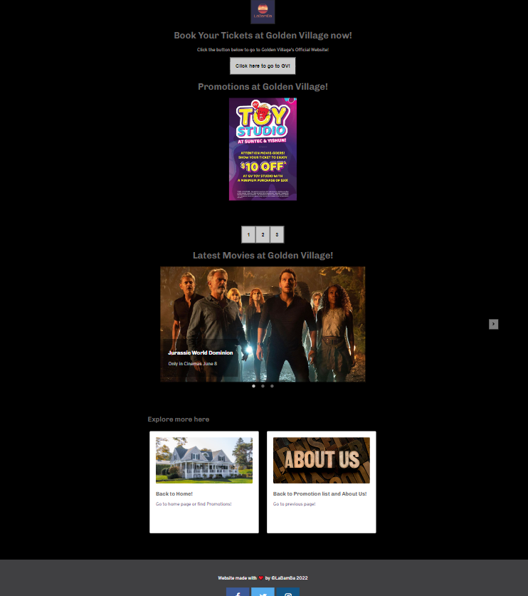
LaBamBa logo will lead us back to home page when clicked
Button “Click here to go to GV” leads us to Golden Village official website
Promotional pictures are toggleable by clicking on “1” “2” or “3”
Carousell are toggleable by clicking on the circles below the image or arrows
Navigation tab under “Explore more here”.

Slide 14
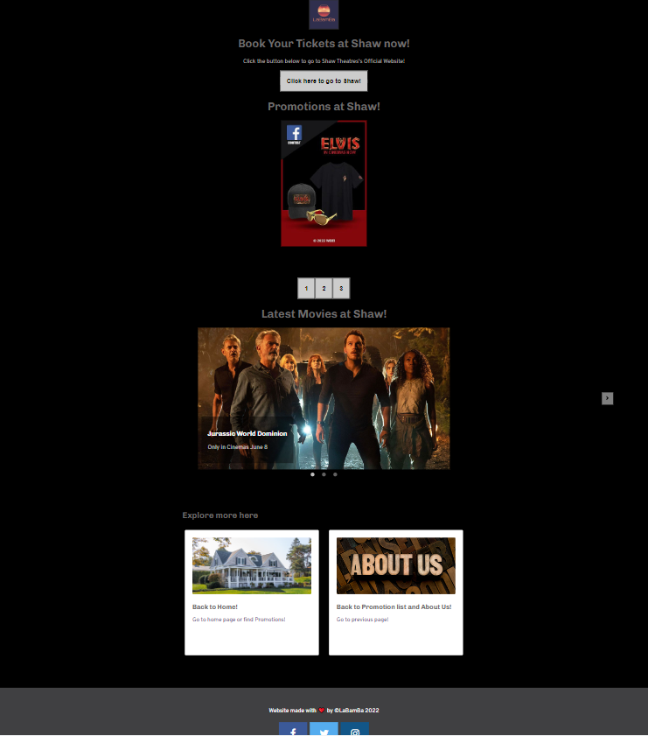
LaBamBa logo will lead us back to home page when clicked
Button “Click here to go to Shaw” leads us to Shaw Theatre’s official website
Promotional pictures are toggleable by clicking on “1” “2” or “3”
Carousell are toggleable by clicking on the circles below the image or arrows
Navigation tab under “Explore more here”.

Slide 15
Listing.html
List of movies

Slide 16
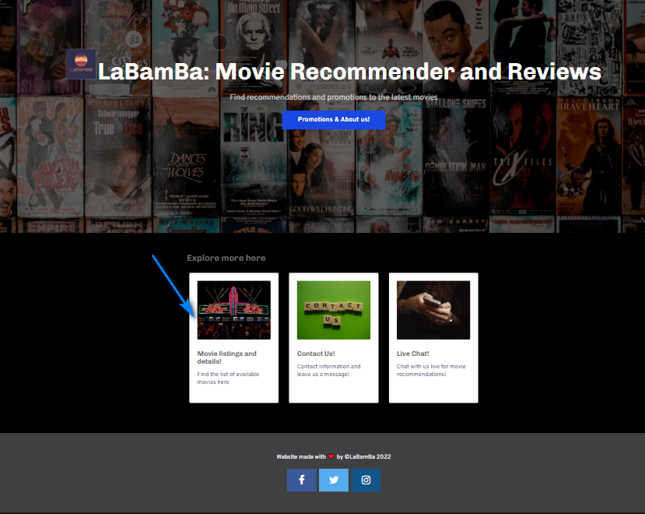
Click on “Movie Listings and details!” card

Slide 17
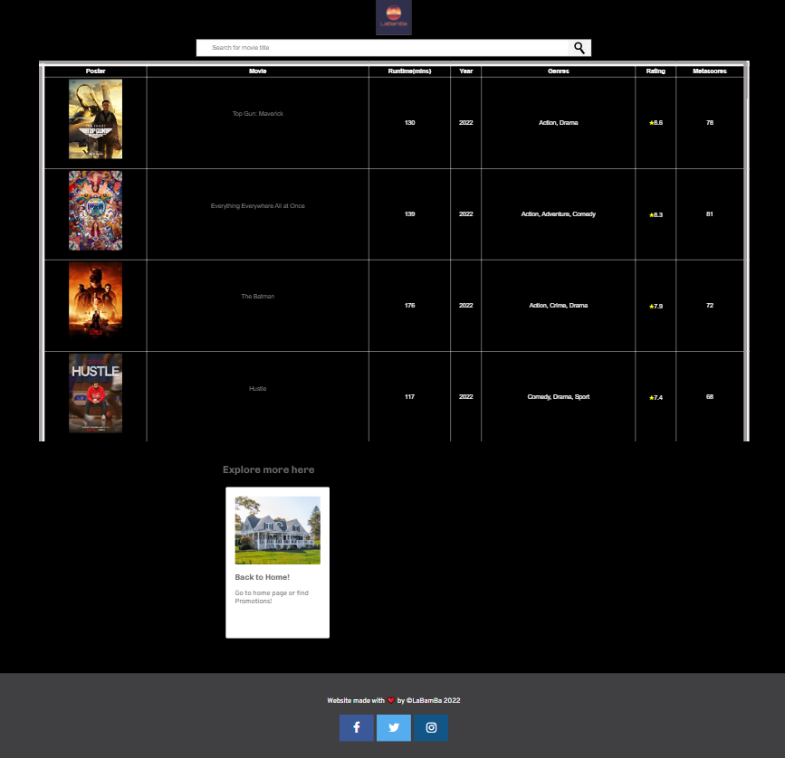
LaBamBa logo will lead us back to home page when clicked
Search bar is interactive, when you type part of the movie name, it will start filtering by matched characters
Click on Poster or Movie titles to access the `movieDetails_review.html` page.
Navigation tab under “Explore more here”.
All the movie listings are unique and lead to real movie data correspondingly. Data scrapped with codes from IMDB and Google Images. (Youtube is manually collected)

Slide 18
movieDetail.html
Movie details of selected movie

Slide 19
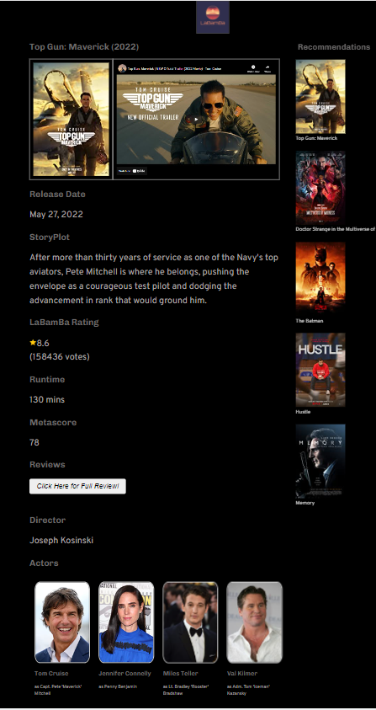
Eg: Top Gun
This is first half of page
Youtube video is embedded.
Recommendations posters or movie names, once clicked will lead to its movie trailer Youtube video
“Click here for Full Review” will lead to its review page under `0.html` since Top Gun is under index 0 of my csv file.
Click on actor poster to lead to IMDB actor’s profile page
LaBamBa logo will lead back to Home Page

Slide 20
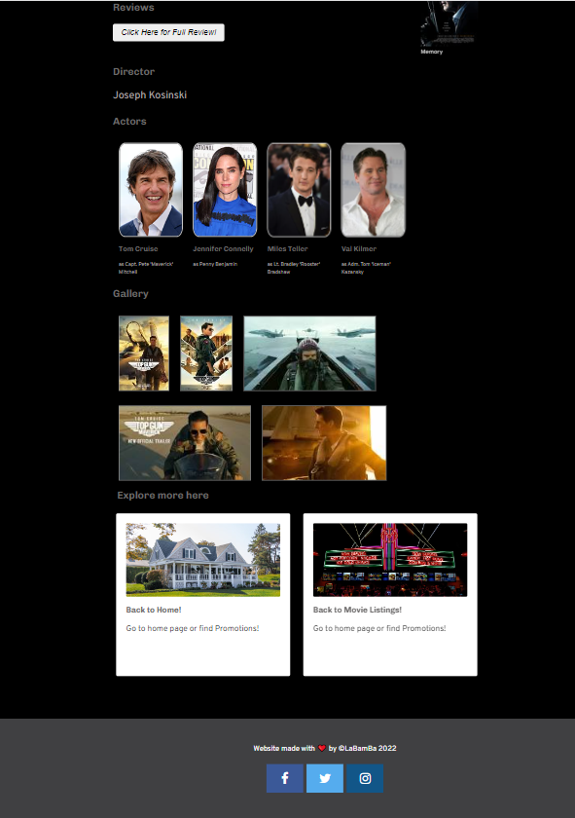
Cont’d
6) Navigation cards under `Explore more here` will lead back to other pages
7) If you open the file `movieReview.html` directly, you will not see the website. You have to select a movie from Listings page at `listings.html` then the relevant data will populate here. It is populated by d3.js and calling the selected id from `localStorage[‘id’]`

Slide 21
movieDetail_Review.html
Movie Review of the selected movie
From `0.html` to `42.html` under folder `reviews_per_movie`

Slide 22
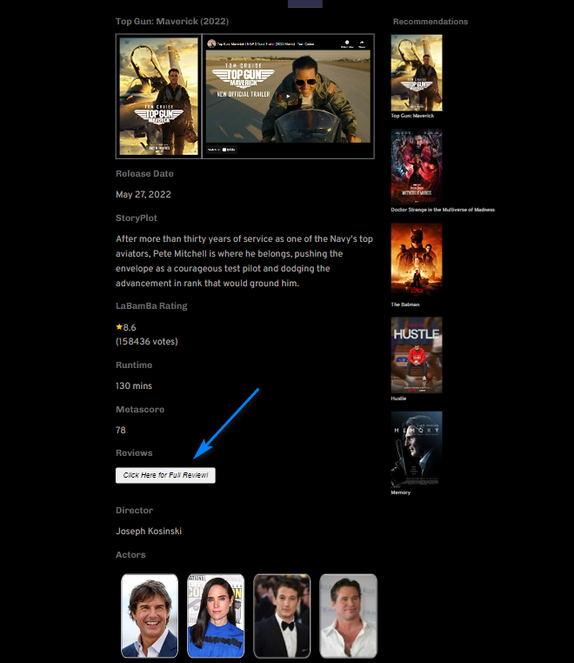
Click on “Click Here for Full Review” to reach the reviews page!

Slide 23
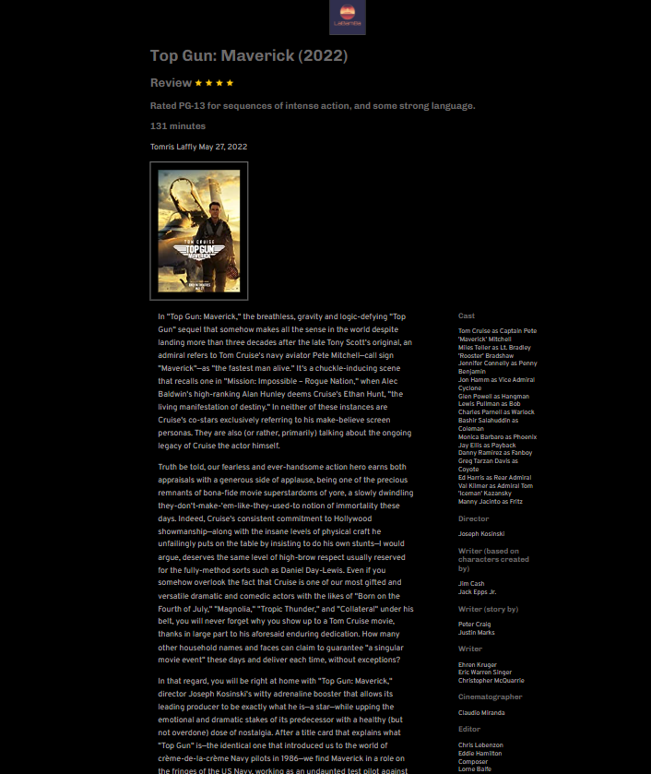
LaBamBa logo will lead back to Home Page
This page content is manually collected from review sites. Since there are `0.html` to `42.html`, I collected from 43 websites. Top Gun review belongs to `0.html`.

Slide 24
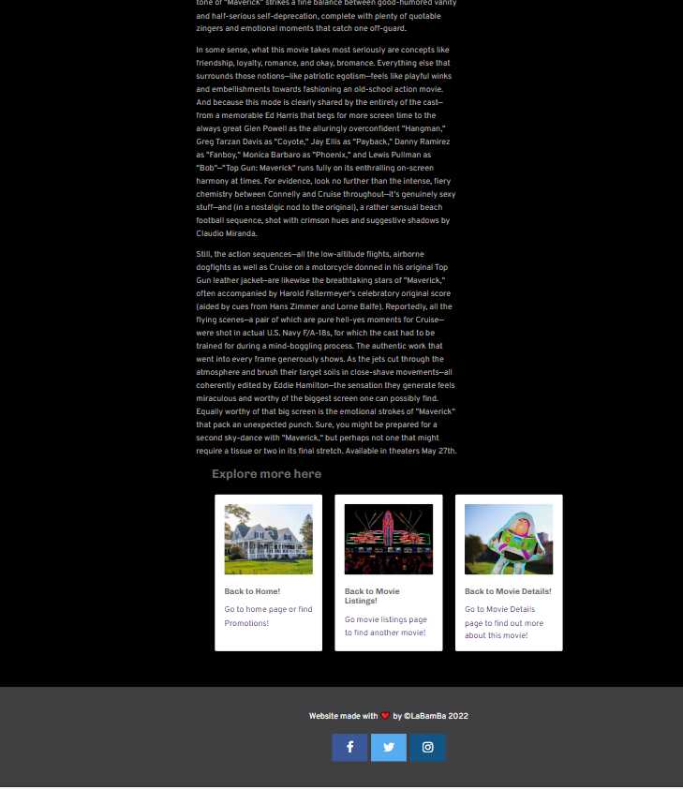
Cont’d
3) Navigation cards under `Explore more here`

Slide 25
Contact.html
Form submission

Slide 26
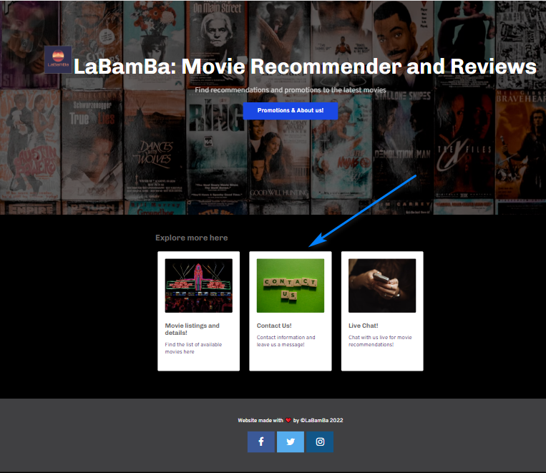
Click on “Contact Us” card from Home Page

Slide 27
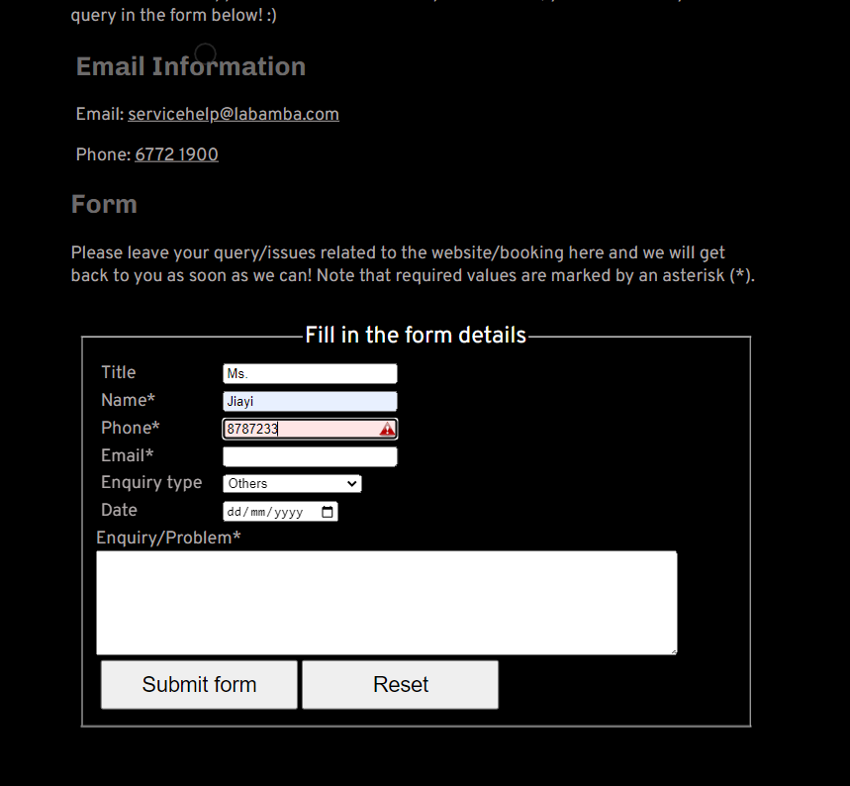
Added form validation feature to all the fields
Submit form button to submit to Google spreadsheet linked to this form.
Reset form to clear all the field boxes

Slide 28
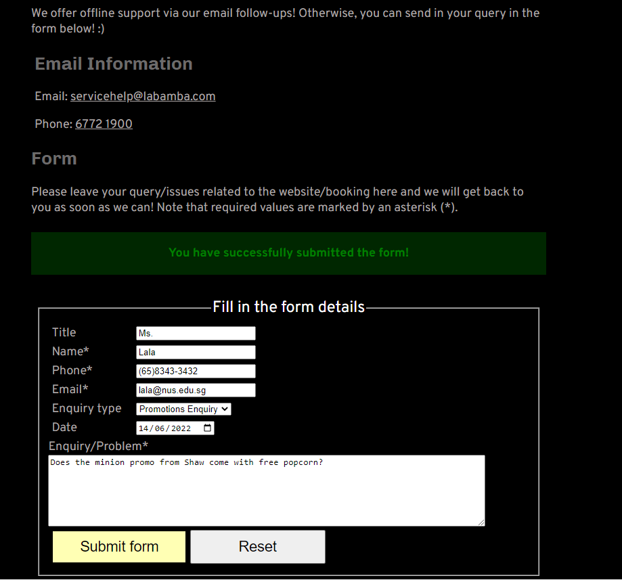
Successful submission will lead to a green success message
User can click on “Reset” to clear page before next submission

Slide 29
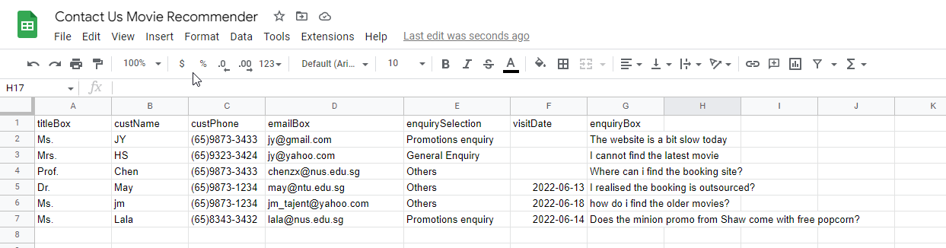
Data is saved directly to my Google sheets, based on address at scriptURL const
And other set up steps from: https://www.youtube.com/watch?v=s9XZui6zRPw

Slide 30
Chatbot.html
Rasa chatbot

Slide 31
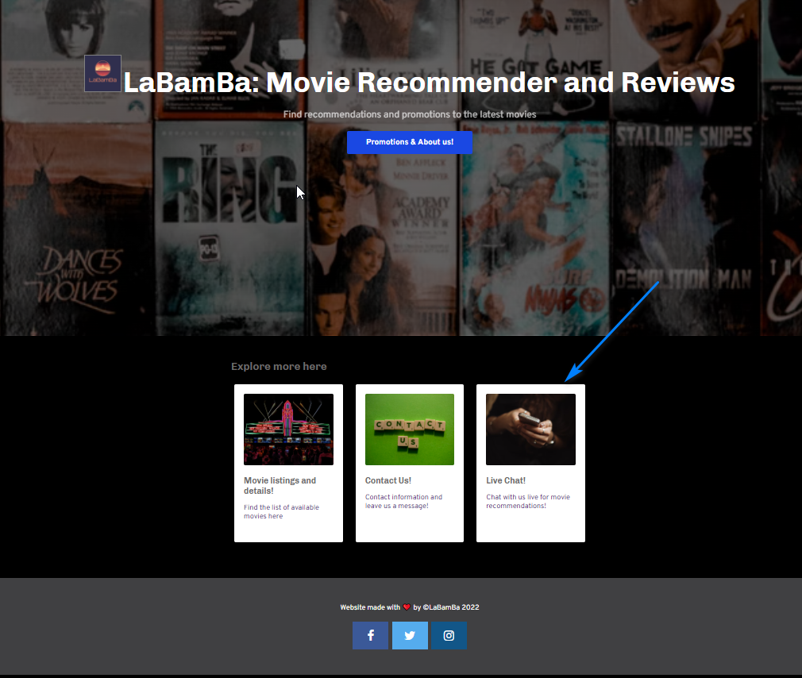
Click on LiveChat!
Bring you to Rasa webchat widget on new windows tab
Connect to Rasa server to local webpage via webhook socket io

Slide 32
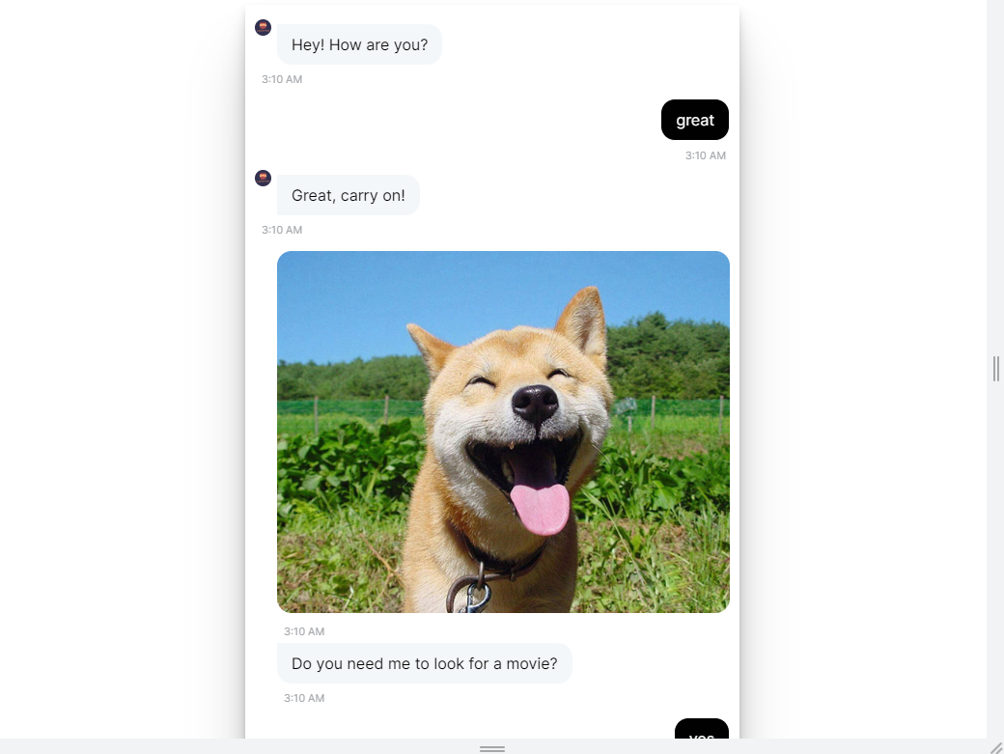
Rasa chatbot served on Rasa Webchat widget. Rasa linked to server via localhost deployment

Slide 33

Further Work
Deploy webapp and Rasa server on Cloud providers
Use Hive and cloud databases to schedule the scrapping data process to database.

Slide 34


Thank You
Name: Chan Jia Yi
Email: jy_tajent@yahoo.com.sg

